Slide 1
DATA 300 Statistical Machine Learning
Chapter 3: Linear regression

Slide 2
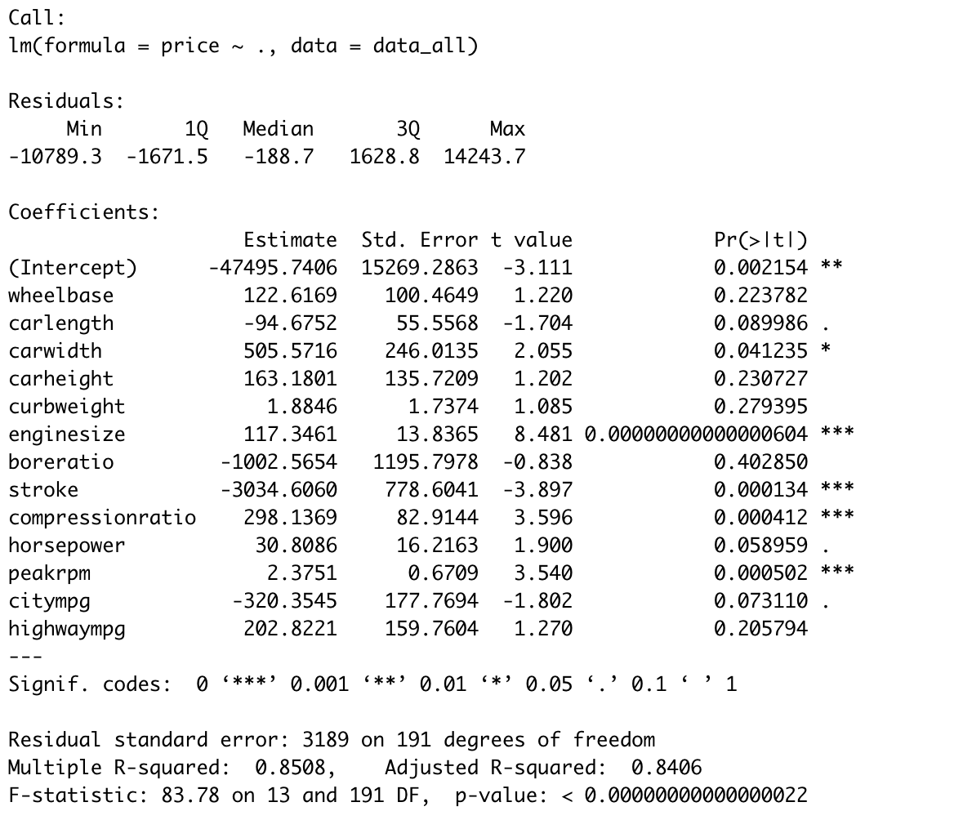
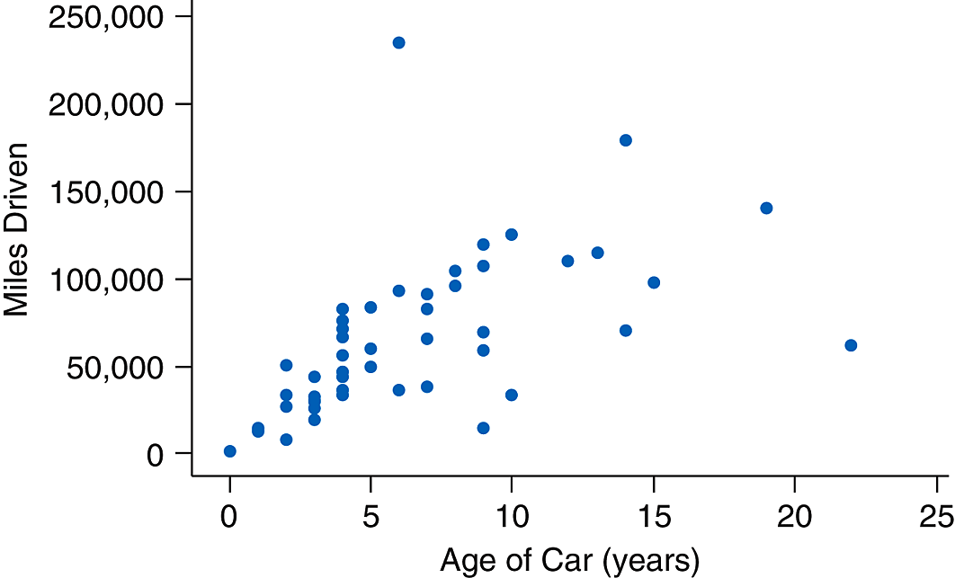
Output from linear regression
To decipher the output of a linear regression model:
Residuals in a model:

Slide 3
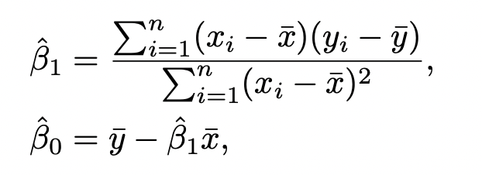
Output from linear regression
To decipher the output of a linear regression model:
Residuals in a model
Estimates (intercept, coefficients for each variable) are obtained by minimizing all the residuals in the model:
Take the first derivative with respect to the intercept, and with respect to the coefficient, we obtain:

Slide 4

Output from linear regression
To decipher the output of a linear regression model:
Residuals in a model
Estimates (intercept, coefficients for each variable) are obtained by minimizing all the residuals in the model.
Pr(>|t|) is the p-value for the following hypothesis testing:
H₀: b_{j}=0
H₁: bj$≠$0
where we need a small p-value to show evidence for H_{1.}

Slide 5
Agenda
Refresh on hypothesis testing
Continue to decipher the output

Slide 6
Toy examples
One principal of the American justice system is that the defendant in a trial should be considered innocent until proven guilty.
What would the null and alternative hypotheses be in the context of a criminal trial?
H_{o}: The defendant is innocent.
H₁: The defendant is guilty.

Slide 7
Toy examples
H_{o}: The defendant is innocent.
H₁: The defendant is guilty.
Then the court looks at the evidence.
If the evidence is likely to be observed with the innocent assumption, then we don’t have strong reason to reject the innocent assumption.

Slide 8
Toy examples
H_{o}: The defendant is innocent.
H₁: The defendant is guilty.
Then the court looks at the evidence.
If the evidence is likely to be observed with the innocent assumption, then we do NOT have strong reason to reject the innocent assumption.
If the evidence is unlikely to be observed with the innocent assumption, then we have strong reason to reject the innocent assumption.

Slide 9
Toy examples
H_{o}: The defendant is innocent.
H₁: The defendant is guilty.
Then the court looks at the evidence. Two things could happen:
If the evidence is likely to be observed with the innocent assumption, then we do NOT have strong reason to reject the innocent assumption.
If the evidence is unlikely to be observed with the innocent assumption, then we have strong reason to reject the innocent assumption.
If you are the prosecutor, which one would you rather happen in order to prove guilty? 1) or 2)?

Slide 10
Toy examples
H_{o}: The defendant is innocent.
H₁: The defendant is guilty.
Then the court looks at the evidence. Two things could happen:
If the evidence is likely to be observed with the innocent assumption, then we do NOT have strong reason to reject the innocent assumption.
If the evidence is unlikely to be observed with the innocent assumption, then we have strong reason to reject the innocent assumption.
Likely = higher probability OR unlikely = higher probability?

Slide 11
Toy examples
H_{o}: The defendant is innocent.
H₁: The defendant is guilty.
Then the court looks at the evidence. Two things could happen:
If the evidence is likely to be observed with the innocent assumption,
1) If the evidence happens with high probability under the innocent assumption, then we do NOT have strong reason to reject the innocent assumption.
If the evidence is unlikely to be observed with the innocent assumption,
2) If the evidence happens with low probability under the innocent assumption, then we have strong reason to reject the innocent assumption.

Slide 12
Toy examples
H_{o}: The defendant is innocent.
H₁: The defendant is guilty.
Then the court looks at the evidence. Two things could happen:
If the evidence happens with high probability under the innocent assumption, then we do NOT have strong reason to reject the innocent assumption.
If the evidence happens with low probability under the innocent assumption, then we have strong reason to reject the innocent assumption.
The probability of observing the evidence under the null assumption is called the p-value.
We want the p-value to be small in order to statistically support our alternative hypothesis.

Slide 13
Summary of hypothesis testing
There are always two hypotheses, and the alternative hypothesis (H₁) should ALWAYS be the one you are trying to validate.
If the data (evidence) collected is unlikely to be observed under the null hypothesis (H₀), we call the data statistically significant enough to reject H₀. This corresponds to a small p-value.
Otherwise, we are NOT able to reject H₀.

Slide 14
Hypothesis testing in linear regression
$$Car price=b_{0}+b_{1}∗Car length$$
H₀: $b_{1}$ = 0.
H₁: $b_{1}≠0$.
Same idea, to test these hypotheses, we collect car length and car price data. If the data suggests that shorter cars are more expensive, the p-value is:
The probability of observing this phenomenon under the null assumption.
Therefore, if we have a small p-value, we claim that the relationship between car length and car price is statistically significant based on our dataset.
How small of a p-value is “small”?
Field dependent. Common thresholds include 0.05, 0.01, 0.001.

Slide 15
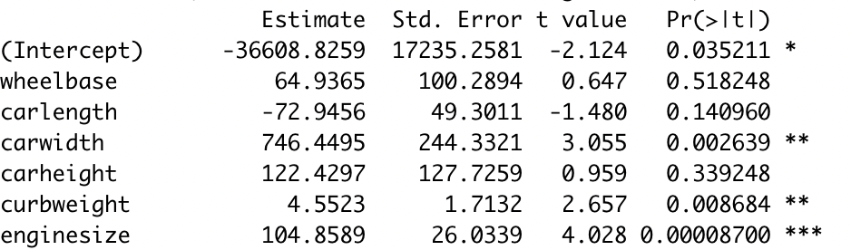
Interpret results from R
P-value
In R, if the Pr(>|t|) is larger than 0.05 (meaning p-value is larger than 0.05), the variable is deemed as statistically insignificant.
The significant variables will have * signs next to them.

Slide 16
Agenda
Refresh on hypothesis testing
Continue to decipher the output
Standard error
F-statistic and R-squared

Slide 17
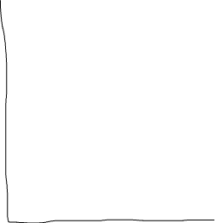
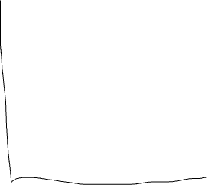
What is the practical meaning of standard error?
What is a good estimation of y for x=10?

Slide 18
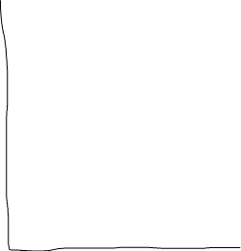
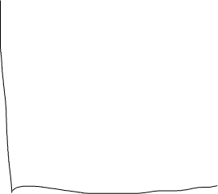
What is the practical meaning of standard error?
Which dataset gives you more confidence in this estimation, why?

Slide 19
What is the practical meaning of standard error?
The practical logic behind linear regression is, for every x value, find the average of y for all sample units sharing this x value.

Slide 20


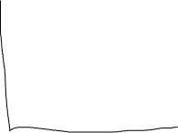
What is the practical meaning of standard error?
The practical logic behind linear regression is, for every x value, find the average of y for all sample units sharing this x value.
With this being said, there is always some bias between this estimation and the actual y value.

Slide 21
What is the practical meaning of standard error?
The practical logic behind linear regression is, for every x value, find the average of y for all sample units sharing this x value.
With this being said, there is always some bias between this estimation and the actual y value.
Standard error is to measure the average amount this estimate deviates from the actual values.

Slide 22
Exercise
Standard error is to measure the average amount an estimate deviates from the actual values.
If the actual values are more spread out, do you expect higher or lower standard error?
If there are a lot of sample units at this x value, do you expect the standard error for the y estimate to be higher or lower?

Slide 23
What is the practical meaning of standard error?
Standard error is to measure the average amount an estimate deviates from the actual values.
If the actual values are more spread out, do you expect higher or lower standard error? --- higher
If there are a lot of sample units at this x value, do you expect the standard error for the y estimate to be higher or lower? -- lower

Slide 24
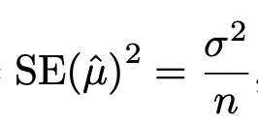
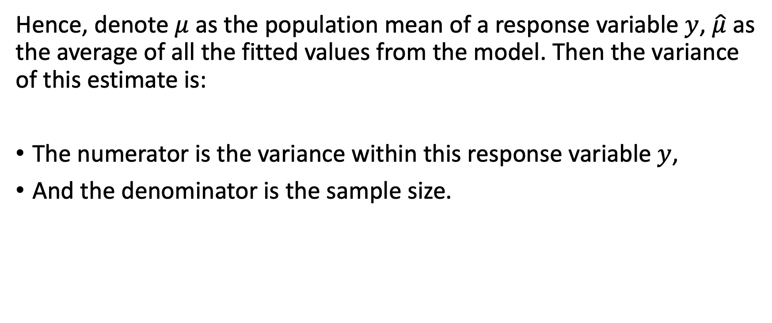
Standard error
Hence, denote $μ$ as the population mean of a response variable $y$, $\hat{μ}$ as the average of all the fitted values from the model. Then the variance of this estimate is:
The numerator is the variance within this response variable $y$,
And the denominator is the sample size.

Slide 25
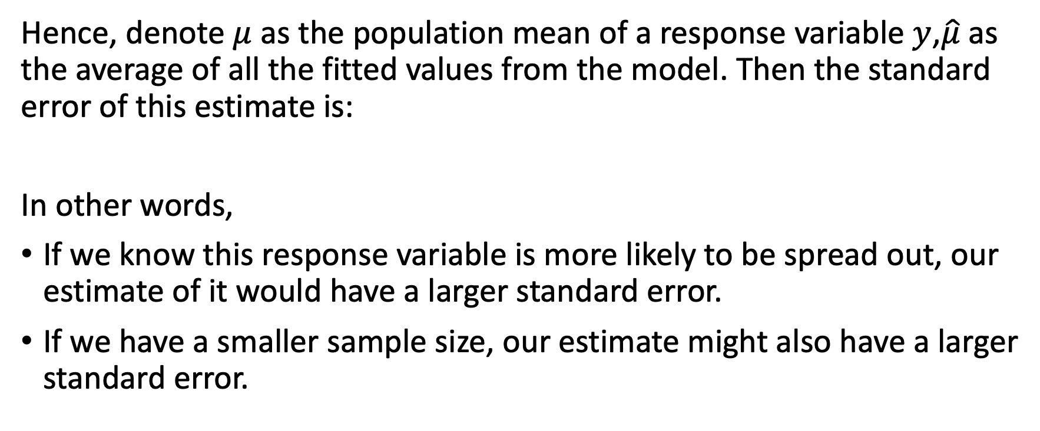
Standard error
Hence, denote $μ$ as the population mean of a response variable $y$,$\hat{μ}$ as the average of all the fitted values from the model. Then the standard error of this estimate is:
In other words,
If we know this response variable is more likely to be spread out, our estimate of it would have a larger standard error.
If we have a smaller sample size, our estimate might also have a larger standard error.

Slide 26
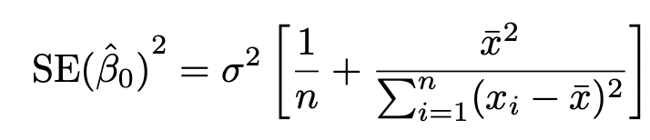
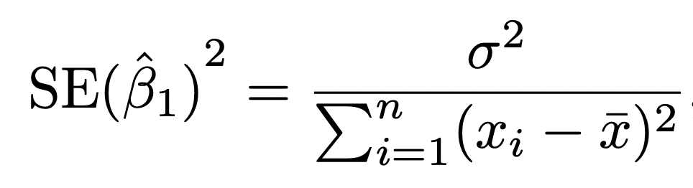
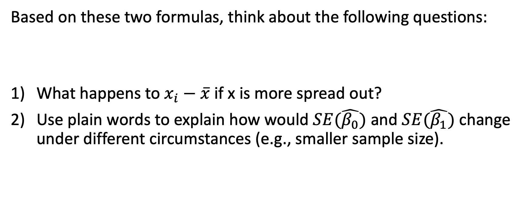
Exercise
Based on these two formulas, think about the following questions:
What happens to $x_{i}−\overline{x}$ if x is more spread out?
Use plain words to explain how would $SE(\hat{β_{0}})$ and $SE(\hat{β_{1}})$ change under different circumstances (e.g., smaller sample size).

Slide 27
Exercise based on R output
Based on
Comparing the standard error for carlength and carwidth, which variable is likely to be more spread out?

Slide 28
Standard error in linear regression
We can construct confidence intervals based on standard error. A 95% confidence interval, for example, is an interval that has a 95% chance of containing the true value.
A 95% confidence interval is constructed as [estimate - 2*SE, estimate + 2*SE].

Slide 29
Exercise
Construct a 95% confidence interval for carlength, as well as carwidth, and interpret both intervals.

Slide 30
How does standard error correlation with p-value?
The 95% interval for car length is [-171, 25.1], and for car width is [258, 1234].
Recall that we want the coefficient of a variable to be non-zero. Which interval gives us more confidence of it being non-zero?

Slide 31
How does standard error correlation with p-value?
The 95% interval for car length is [-171, 25.1], and for car width is [258, 1234].
Recall that we want the coefficient of a variable to be non-zero. Which interval gives us more confidence of it being non-zero?
This is why car width is statistically significant, whereas car length is not.

Slide 32
Agenda
Refresh on hypothesis testing
Continue to decipher the output
Standard error
F-statistic and R-squared

Slide 33
Goodness-of-fit
There are two common measures to measure how well the model fits:
More hypothesis testing!
R-squared.

Slide 34
How well the model “fit” the dataset?
Assuming this is our full model:
$$Car price=b_{0}+b_{1}∗Car length+b_{2} ∗Wheelbase+b_{3}∗Car width$$
H₀: $b_{1}=$ $b_{2}$= $b_{3}$ = 0.
H₁: $At least one of them is NOT 0.$
P-value >0.001
What does it mean for our model if the null hypothesis is true?

Slide 35
How well the model “fit” the dataset?
Assuming this is our full model:
$$Car price=b_{0}+b_{1}∗Car length+b_{2} ∗Wheelbase+b_{3}∗Car width$$
H₀: $b_{1}=$ $b_{2}$= $b_{3}$ = 0.
H₁: $At least one of them is NOT 0.$
What does it mean for our model if the null hypothesis is true?
Model is useless and all the variables we picked have nothing to do with car price.

Slide 36
How well the model “fit” the dataset?
Assuming this is our full model:
$$Car price=b_{0}+b_{1}∗Car length+b_{2} ∗Wheelbase+b_{3}∗Car width$$
H₀: $b_{1}=$ $b_{2}$= $b_{3}$ = 0.
H₁: $At least one of them is NOT 0.$
That is why we want the dataset to be able to validate the alternative hypothesis. Again, we calculate the probability of observing this dataset if the null hypothesis is true, which is p-value.
If p-value is small, what does it entail?

Slide 37
How well the model “fit” the dataset?
Assuming this is our full model:
$$Car price=b_{0}+b_{1}∗Car length+b_{2} ∗Wheelbase+b_{3}∗Car width$$
H₀: $b_{1}=$ $b_{2}$= $b_{3}$ = 0.
H₁: $At least one of them is NOT 0.$
That is why we want the dataset to be able to validate the alternative hypothesis. Again, we calculate the probability of observing this dataset if the null hypothesis is true, which is p-value.
If p-value is small, we call that the data is statistically significant enough to reject the null hypothesis, and that at least one of the variables has a statistically significant relationship with car price.

Slide 38
How well the model “fit” the dataset?
Assuming this is our full model:
$$Car price=b_{0}+b_{1}∗Car length+b_{2} ∗Wheelbase+b_{3}∗Car width$$
H₀: $b_{1}=$ $b_{2}$= $b_{3}$ = 0.
H₁: $At least one of them is NOT 0.$
Testing whether at least one of the variables is significant or none of them is significant is called a F-test.
F-test is a type of hypothesis testing based on the F-statistic.

Slide 39
Interpret results from R
If p-value is small than a threshold, then we have enough evidence to claim that at least one of the variables is having a statistically significant relationship with car price.
Otherwise, there is NO evidence to claim that ANY of the variables is statistically significant.
A few common thresholds: 0.05, 0.01, 0.001.

Slide 40
Goodness-of-fit
There are two common measures to measure how well the model fits:
More hypothesis testing!
R-squared.

Slide 41
R-squared
Another way to approach the “goodness-of-fit” is to measure to what level the response variable could be explained by the linear regression model.

Slide 42
Flashback
The first goal for building a linear regression model is to explain the response variable using the independent variables with the training dataset:
This is common in (traditional) social science, where the dataset is collected via lab experiments.
This is also called “goodness-of-fit”.

Slide 43
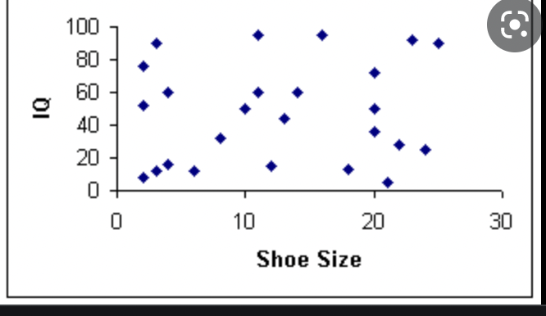
When the predictors cannot explain the response variable..
When shoe size increases, IQ often …?

Slide 44
When the predictors cannot explain the response variable..
There does not seem to be an obvious relationship (of course) between shoe size and IQ. In other words, shoe size is not a good explanation for IQ.

Slide 45
When the predictors cannot explain the response variable..
There does not seem to be an obvious relationship (of course) between shoe size and IQ. In other words, shoe size is not a good explanation for IQ.
In this scenario, if I forcefully ask you to predict the IQ for somebody with a shoe size of 8.5, what is your best guess?

Slide 46
When the predictors cannot explain the response variable..
There does not seem to be an obvious relationship (of course) between shoe size and IQ. In other words, shoe size is not a good explanation for IQ.
In this scenario, if I forcefully ask you to predict the IQ for somebody with a shoe size of 8.5, what is your best guess? ---use the average of IQ

Slide 47
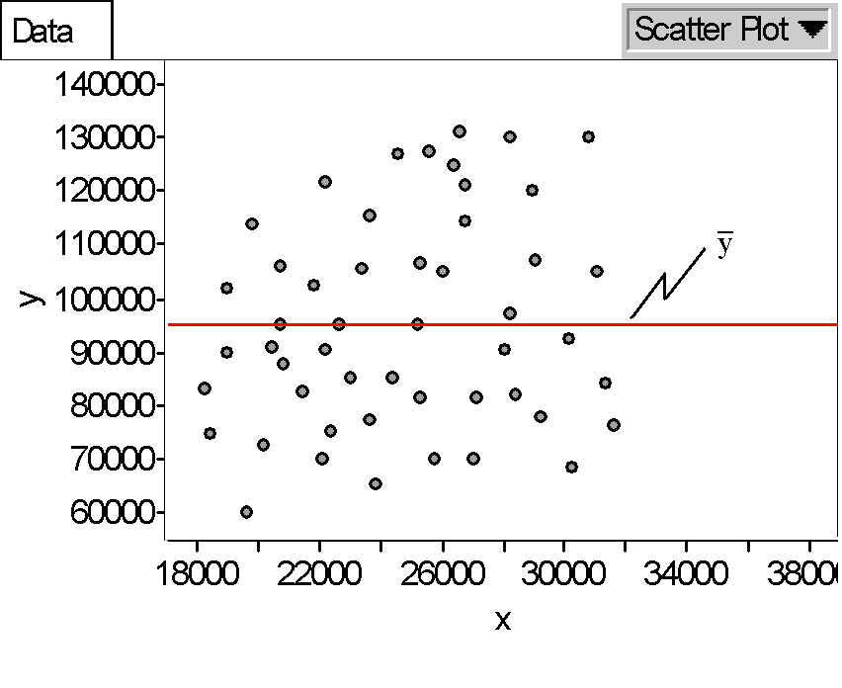
In fact..
A benchmark in prediction is ALWAYS to simply predict using the average of the response variable.

Slide 48
In fact..
A benchmark in prediction is ALWAYS to simply predict using the average of the response variable.
In other words, we are assuming the predictor(s) does not have any explanation power.

Slide 49
Goodness-of-fit
A benchmark in prediction is ALWAYS to simply predict using the average of the response variable.
Since this is the benchmark, we can measure the “goodness-of-fit” of a model by looking at the difference between $\hat{y}$ (estimation given by the model) and $\overline{y}$ (estimation give by the average)

Slide 50
Goodness-of-fit
The difference between $\hat{y}$ (estimation given by the model) and $\overline{y}$ (estimation give by the average), specifically the difference between the SSE (residuals) using $\hat{y}$ and the SSE using $\overline{y}$, is defined as R-squared.
Mathematically, R-squared is the percentage of the variation in the response variable that is explained by the linear regression model.

Slide 51
Interpreting results in R
R squared is always in between 0 and 1 (or 0% and 100%).
A R-squared = 0.8508, for example, suggests that 85.08% of the variation in car price could be explained by this linear regression model.

